Slide 1

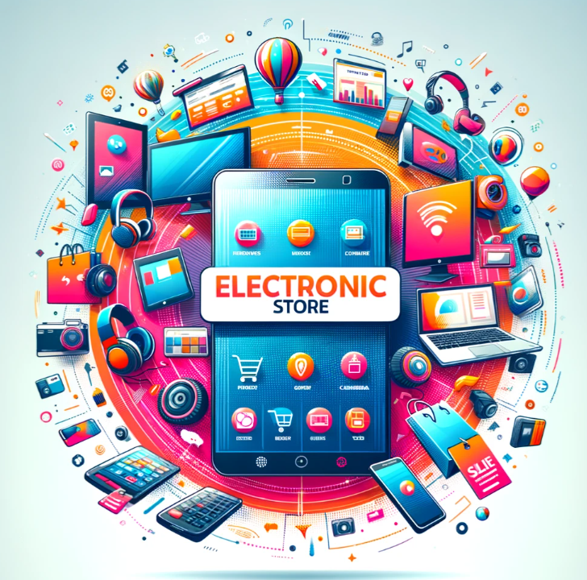


E-COMMERCE
Electronic Store–web Application
Team members:
Hoson Hasqoor 1191003
Maryam Raslan 1191924
Rawan Firas 1191677
Supervisor: Mr. Saadeddin Hroub
2024

Slide 2





Table of contents
01
Introduction to Electronic Store
07
02
08
Project Overview
09
Func-NonFunctional requierment
03
Motivation and Background
10
System Diagrams
04
Objectives
11
Design Stage
05
Methodology
12
06

Slide 3

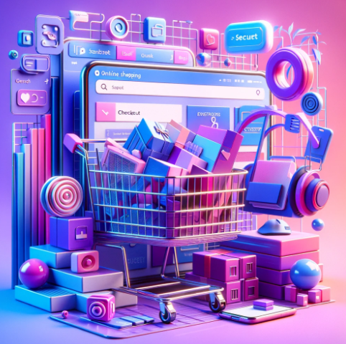
01
Introduction to Electronic Store

Slide 4
Introduction to Electronic Store
Today in the world everything happens online, electronics stores have become excellent at giving you all the important details about smart devices. They make it easier for you to choose what you want by sharing information about many different devices. This helps you choose faster and reduce mistakes when purchasing electronic devices. They aim to make shopping for different smart devices easy for you.

Slide 5
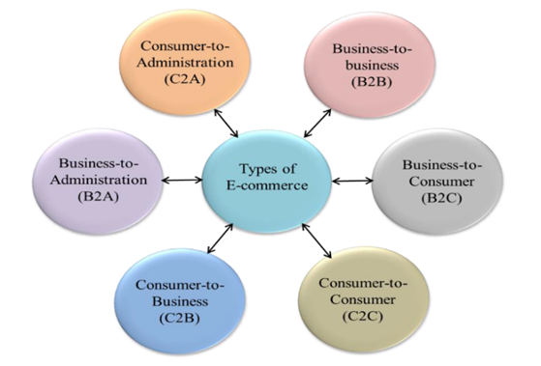
Business to Consumer (B2C)
Business-to-Business (B2B)
When companies sell things directly to people online, just like regular shopping but online. You can buy all kinds of things like electronics and food.
When companies sell things online to each other, such as large manufacturers and wholesalers.
Types of e-commerce
Consumer to Business (C2B)
Consumer to Consumer (C2C)
When people sell their services or things to companies. For example, someone might create a logo, and companies pay for the logo they like
When people sell things to each other over the Internet using a web application designed for that.
Consumer to Administration (C2A)
Business to Administration (B2A)
When people do things online with the government, like paying taxes, getting health information, or doing things for education.
When companies deal with government online, such as tax, health care, and legal matters.

Slide 6

02
Project Overview

Slide 7

Project Overview
It identifies the specific problem of the lack of
a local online platform for selling electronic devices
in Palestine and proposes a solution that addresses the needs and preferences of customers and suppliers.
It provides a thorough background and literature review of the topic of e-commerce, it also compares and analyzes related works of similar web applications, highlighting their features and gaps.
Innovative and user-friendly features: The project introduces some innovative and user-friendly features for the web application, such as product comparison, online payment, chat service, notification system, and feedback mechanism. These features aim to enhance the user experience and satisfaction, as well as the efficiency and security of the online transactions.

Slide 8
03
Motivation and Background

Slide 9
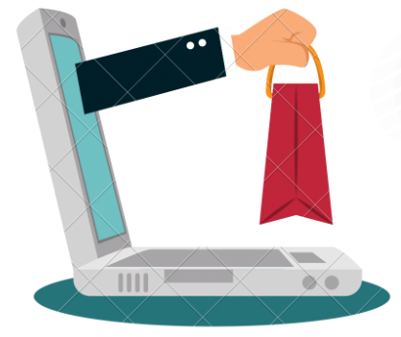
Motivation and Background
The Electronic Store Project
The "Electronic Store" project started because nowadays everything is online, and it's important for people to easily find out about different smart gadgets before they buy them. This project wants to make it easier for everyone to shop online, especially for electronics, by giving them all the info they need. It also looks at how e-commerce (or online shopping) is growing because it's easy, saves money, and you can shop from anywhere.
The electronic portal for Palestinian stores and companies
But, there's a special focus on helping local shops in Palestine get noticed online. The goal is to create a website where Palestinian stores can sell their gadgets online, making it easier for people to find and buy from them. This way, local shops get more customers, and people can learn more about Palestinian electronics. The idea is to make the website super easy to use so anyone looking for gadgets can find what they need, learn about it, and buy it without any hassle.

Slide 10
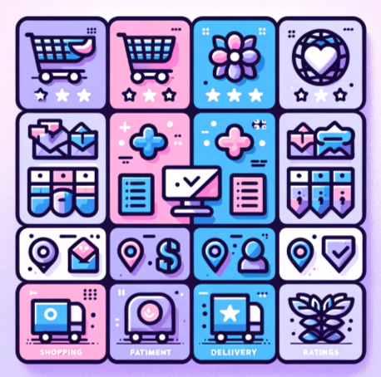
Comparison of E-commerce Features Across Different website

Slide 11
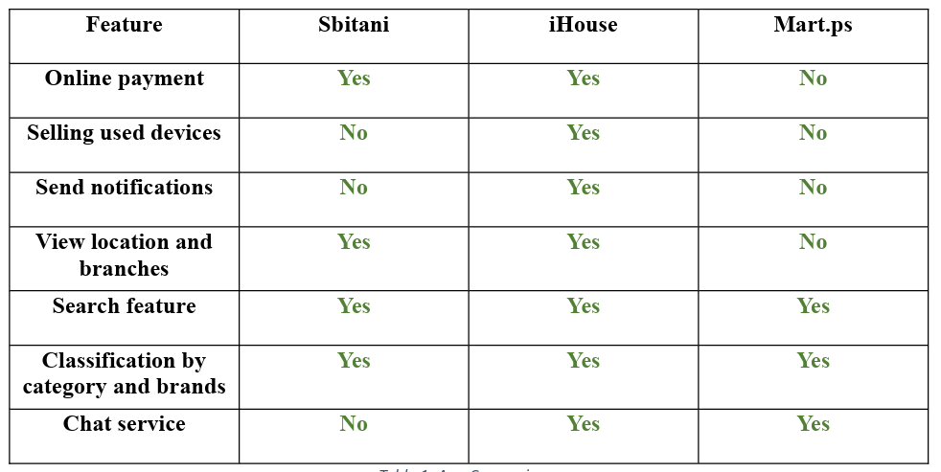
show the comparison table

Slide 12
04
Objectives

Slide 13
Objectives
"Electronic Store" project sets clear goals to make online shopping for electronics a breeze in Palestine.
Build an Easy Website
Save Time and Money
Help Sellers Grow
1
2
3
2
To reduce the time and effort of the search process for customers and save their money through the offers and gifts that companies will provide through the web application.
3
Design an easy-to-use interface to help people search and buy easily.
To help suppliers increase their sales by providing them with a space to display their products.
Keep Track of Shopping
2
Protect Your Info
4
5
To help customers track the history of their sales operations and help suppliers track their sales through a set of reports.
Implementing strong security measures to protect customer information stored on the electronic web application. This includes the use of advanced encryption protocols.

Slide 14
05
Methodology

Slide 15





Methodology
Problem Understanding and Domain Study
System Analysis
For the model, we will use Agile Development because it is more flexible in e-commerce applications.
02
03
Application Development
04
Testing and Improvement

Slide 16
06
Key Features

Slide 17
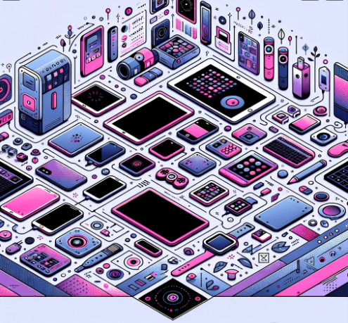
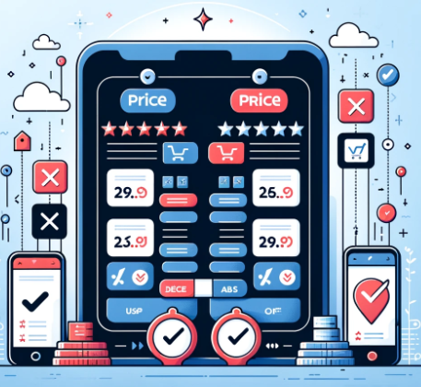
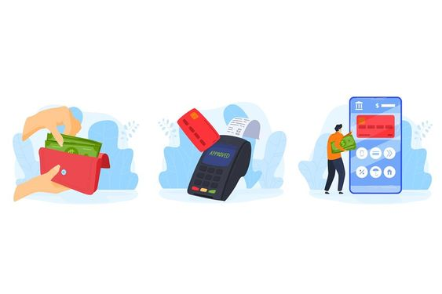

Device Classification
Device Classification
Price Comparison
Online Payment
Notifications
alerting companies when a product sells out or when a specific product is ordered
Organize devices by type, company, and brand to facilitate search.
Allowing the display and comparison of the same device
from
multiple companies
Incorporating secure online payment options.
.

Slide 18
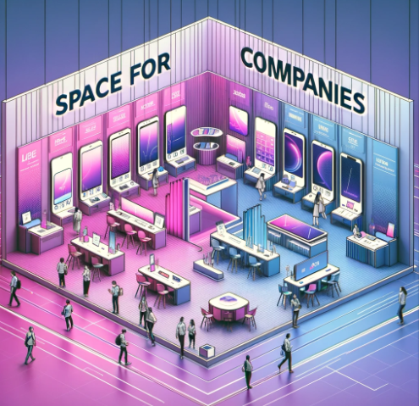

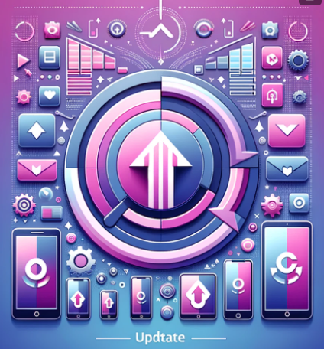

Device Classification
Space for Companies
Search Functionality
Update devices
Company Info and Chat
Offering companies their own space to display devices.
Enabling users to search by product name.
Allowing for the addition and modification of device specifications.
Providing company information and enabling a chat feature for customer interaction.

Slide 19
Main Features
For customers
For company suppliers
chatting
Update devices
Home page
Login /log out
Shopping
cart
Registration
Discount space
Online payment
Contact and about us
Cancel the order
Filter search
Display devices and their classification
Receive notification
Device evaluation
View orders

Slide 20
07
Technology Stack

Slide 21





Technology Stack
HTML
CSS
Bootstrap
ASP.NET
MySQL
Introduction to Web Technologies
The "Electronic Store" uses HTML and CSS for a sleek design, Bootstrap for responsiveness, ASP.NET for robust server-side functions, and MySQL for dependable data management.

Slide 22
08
Challenges and Solutions

Slide 23
The online electronics market in Palestine is fragmented, lacking a unified platform tailored to local needs, impacting trust and visibility for businesses and consumers. What Others Did: Existing platforms partially address these issues but often miss providing a localized, comprehensive solution that fully supports both seller verification and customer engagement.
Problem Statement:

Slide 24
Our solution focuses on creating a platform that bridges this gap by offering robust seller verification, enhancing visibility for local sellers, and providing diverse payment options and dedicated customer support, tailored specifically to the Palestinian market.
Solutions Statement

Slide 25

09

Slide 26
Functional Requirements
Non-Functional Requirements
UR1: The system shall enable the users to manage their profiles, including username and password.
UR2: The system shall allow the customers to access to the details page of electronic devices, featuring pictures of the device, its specifications, and price.
UR3: The system shall permit company suppliers to add new items.
UR4: The system shall enable customers to interact with the application online.
UR5: The system shall enable customers to add products to the shopping cart.
UR6: The system shall identify and display the best-selling product among companies.
UR7: The system shall notify the company when a product is ordered through the web application.
UR8: The system shall support payment options for customer transactions, including card and PayPal.
Usability: The application should be very simple with a friendly user interface that is easy to use, it should allow login using the third party accounts such as Google or Facebook to facilitate the user's registration on the system.
Availability: The system should be available at 24/7.
Portability: The system should allow users to use the system on all devices, including computers, iPads, and mobile phones.
Security: Strong encryption protocols (such as HTTPS) should be used to protect users' data, encrypt sensitive information such as credit card information, and update the system regularly to correct potential
security vulnerabilities.

Slide 27
10
System diagrams

Slide 28
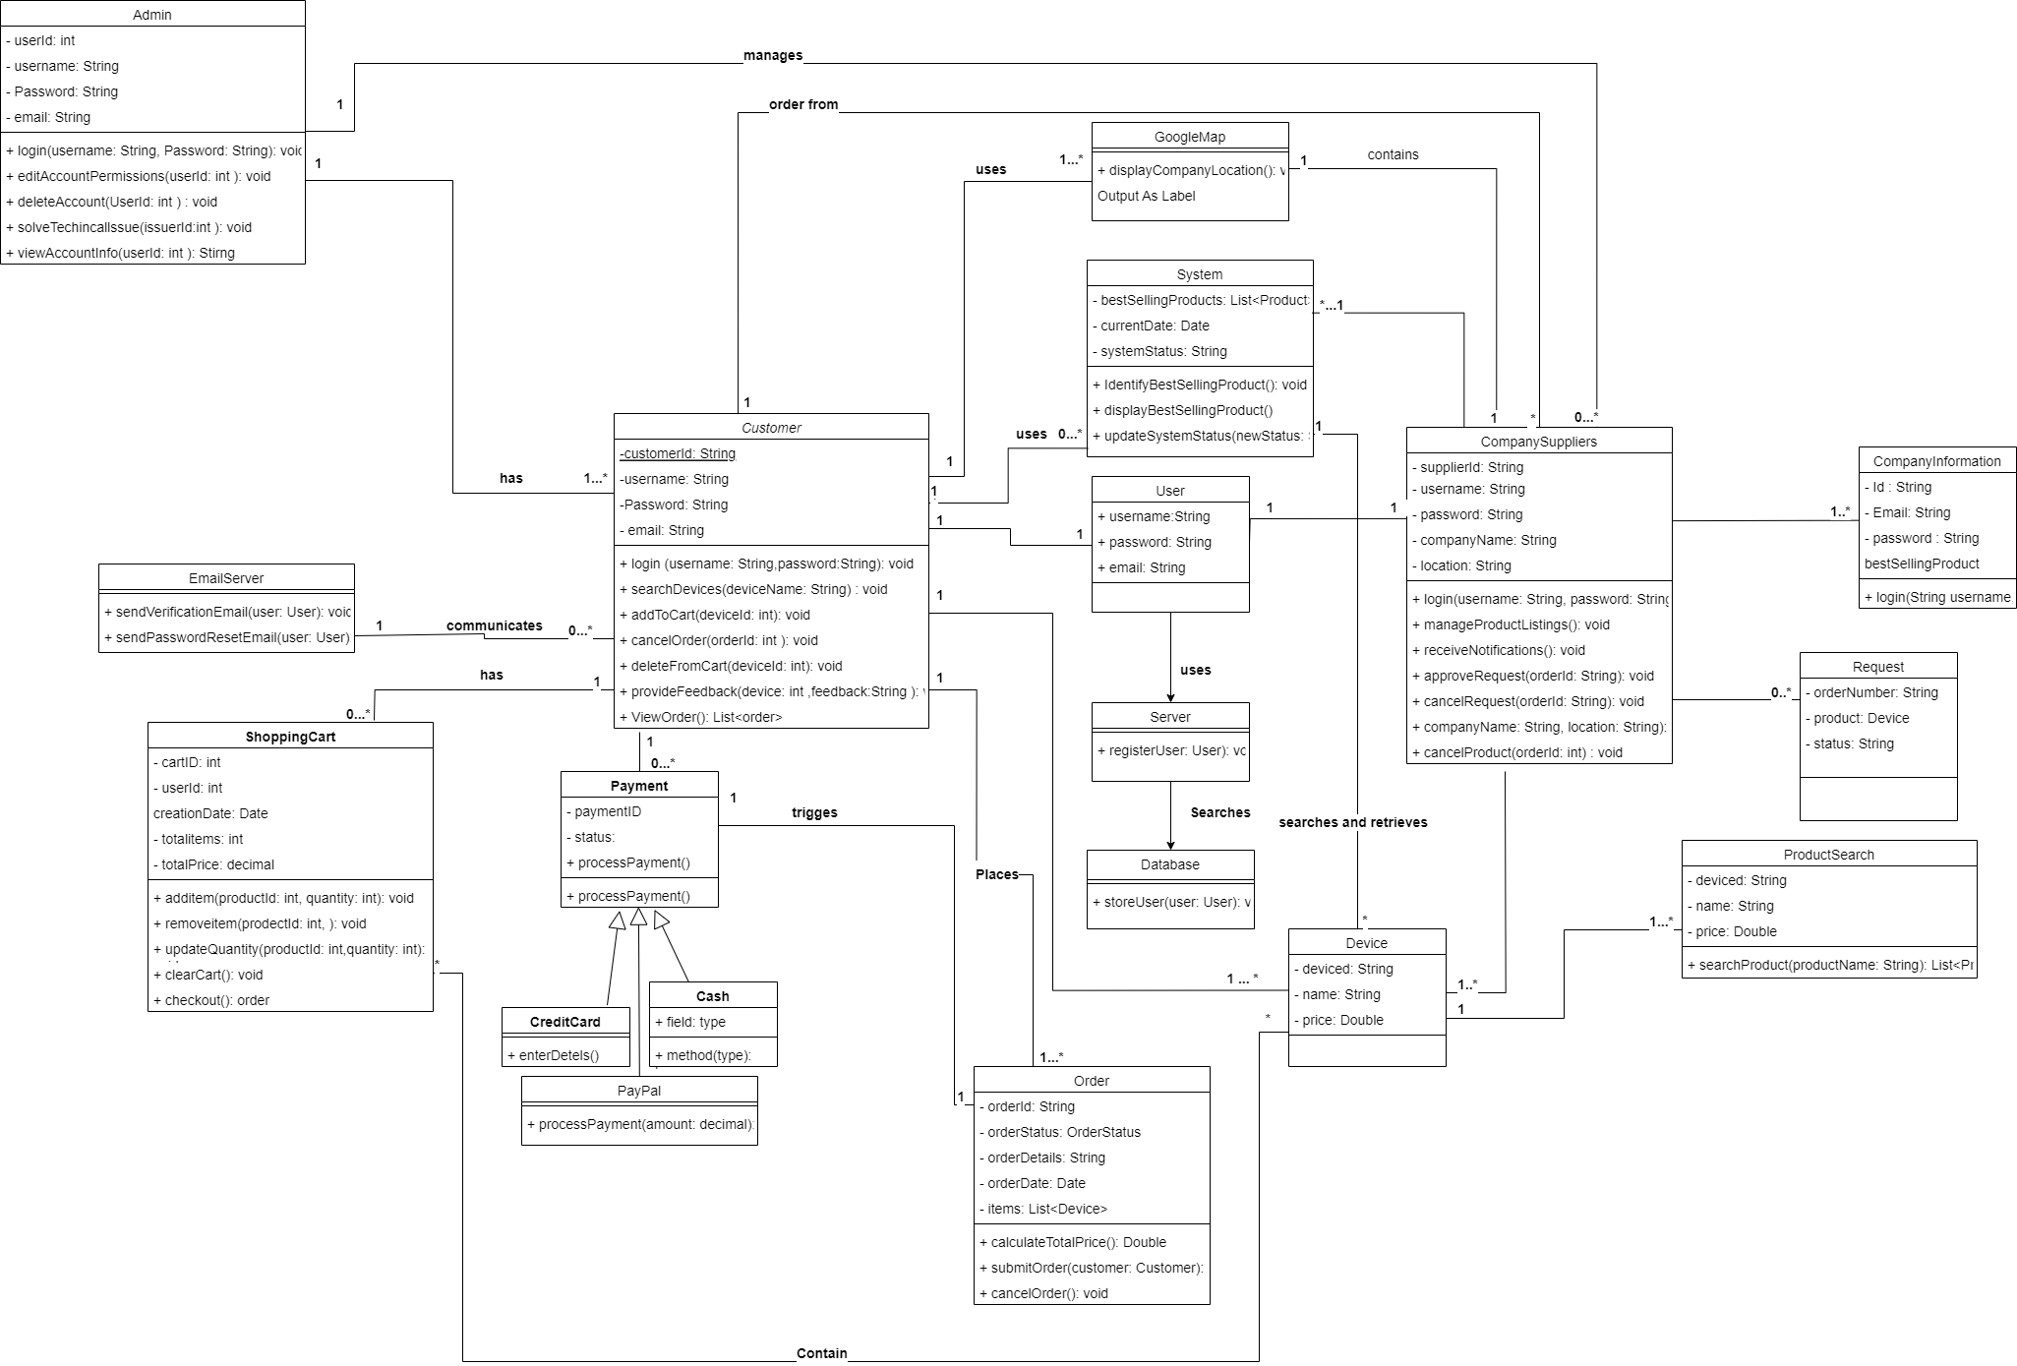
Class diagram

Slide 29
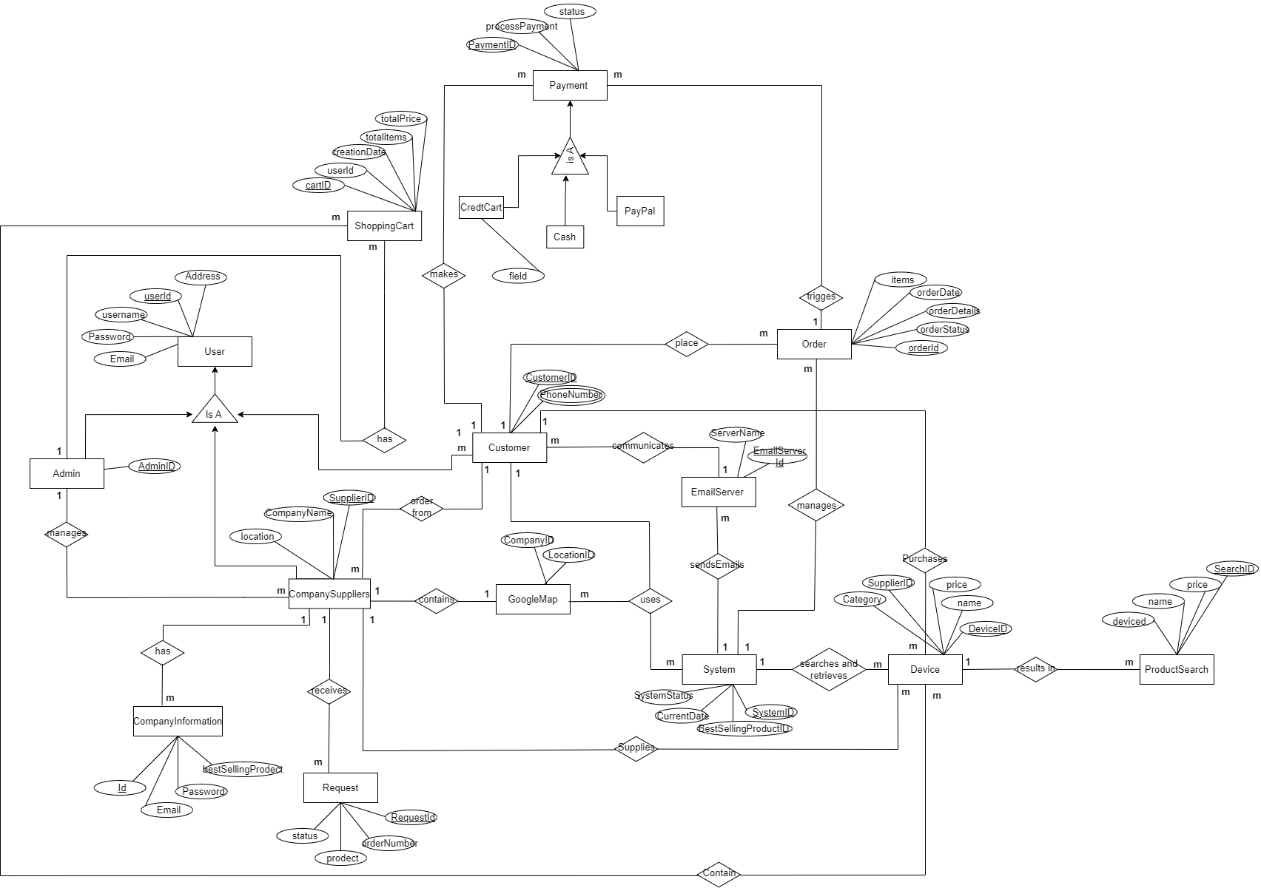
ER Diagram

Slide 30
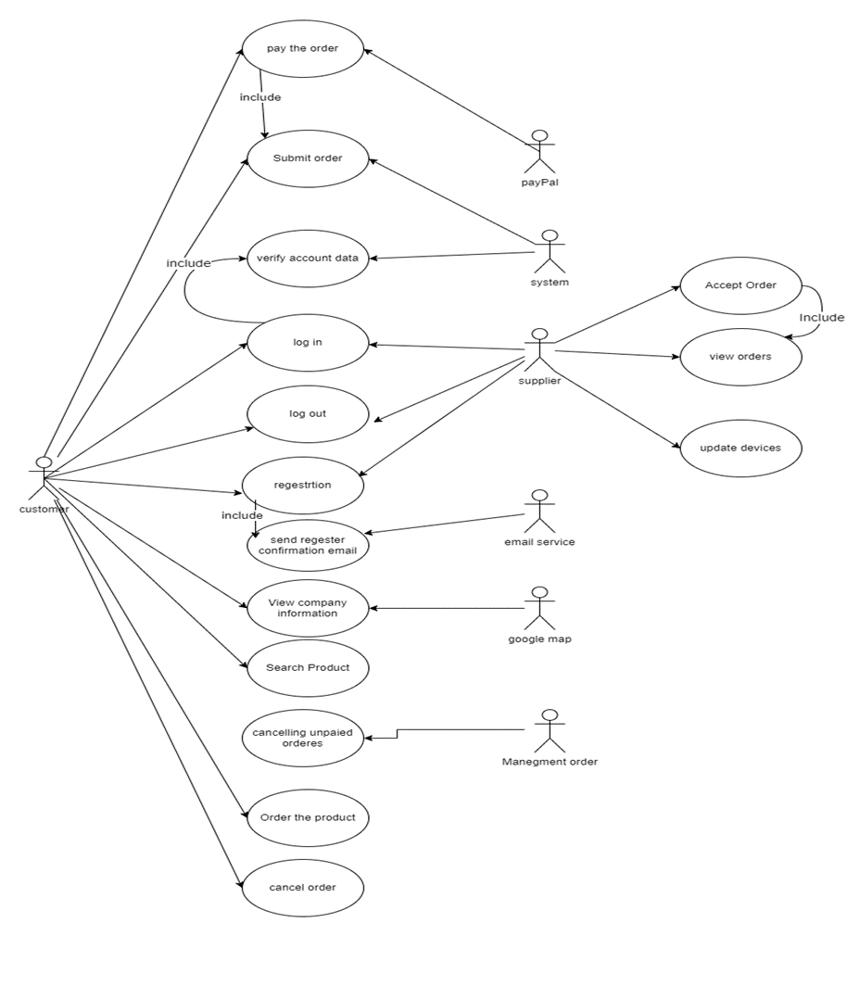
Use Case Diagram

Slide 31
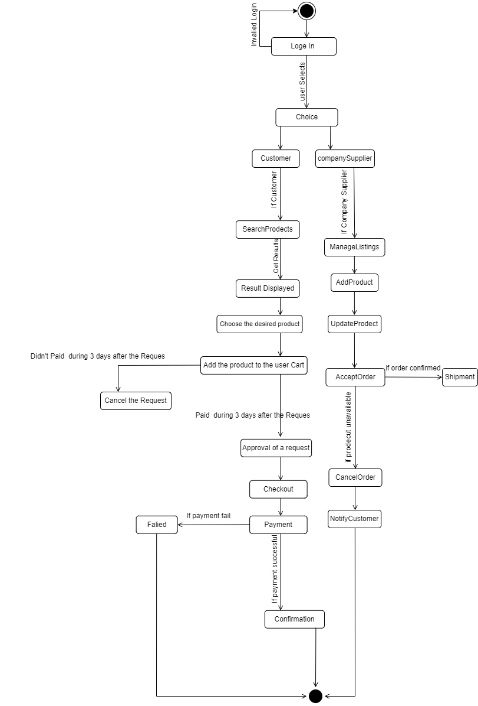
State Diagram

Slide 32
11
Design Stage

Slide 33
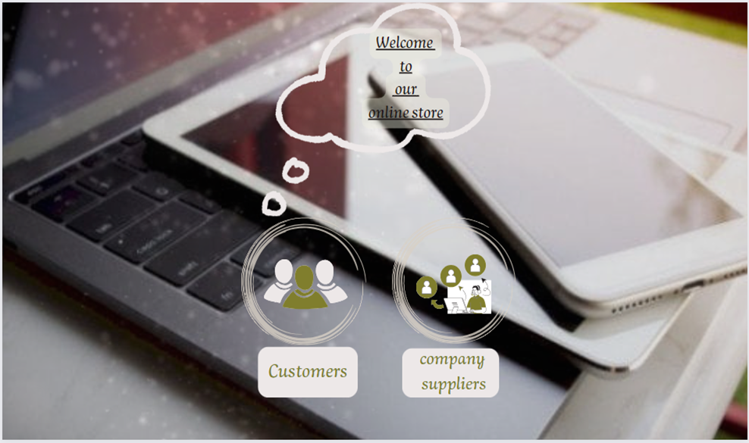
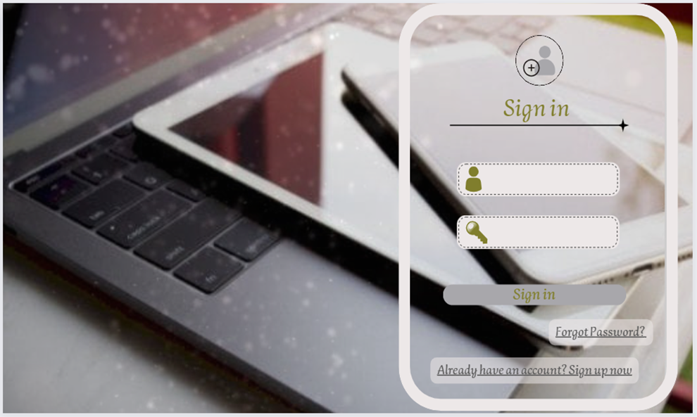
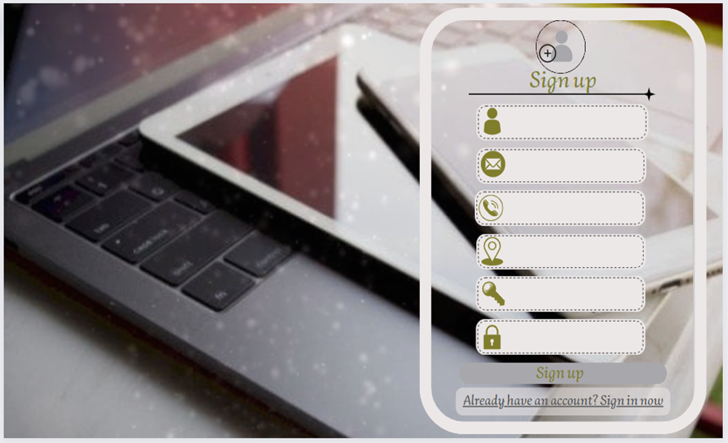
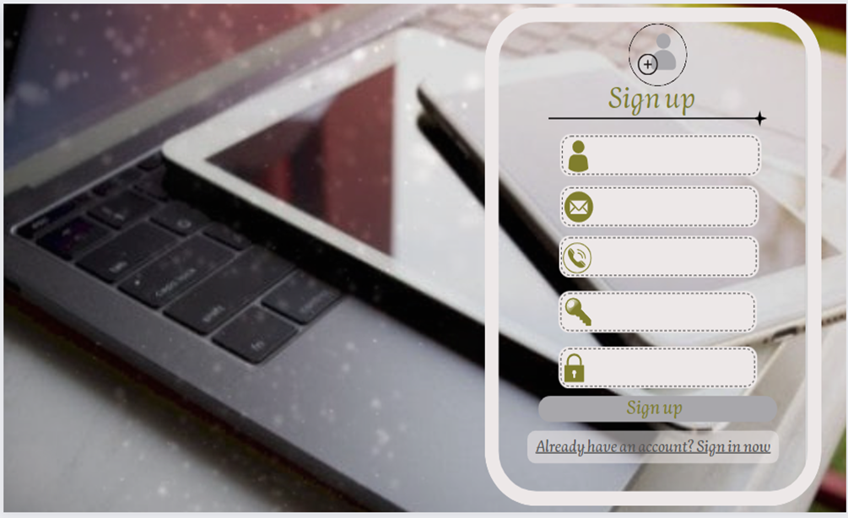
Welcome page and choose the registration type
Sign in page design.
Sign up page design for company suppliers.
Sign up page design for customers

Slide 34
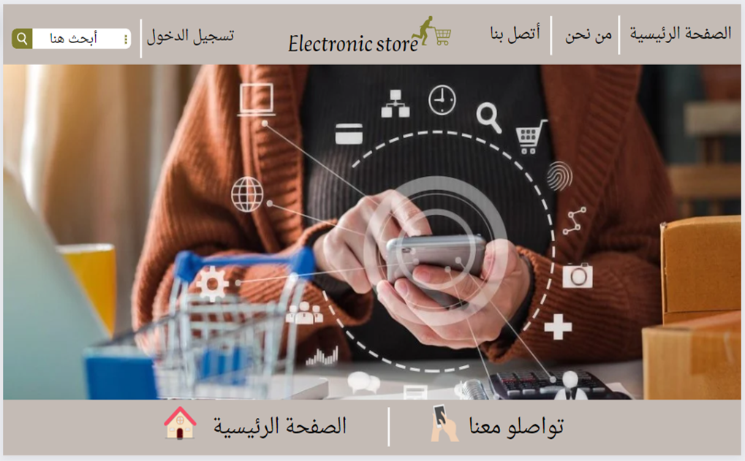
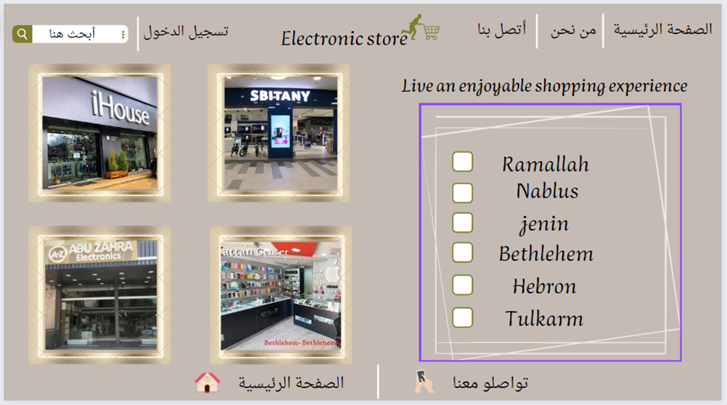
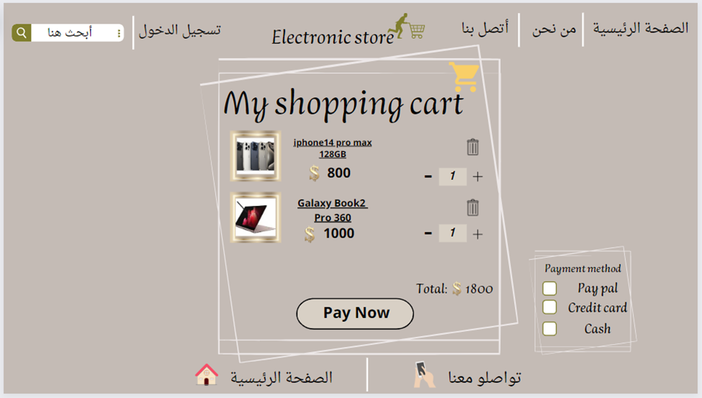
Home page design
List of companies in Palestine page design
Shopping cart page design

Slide 35
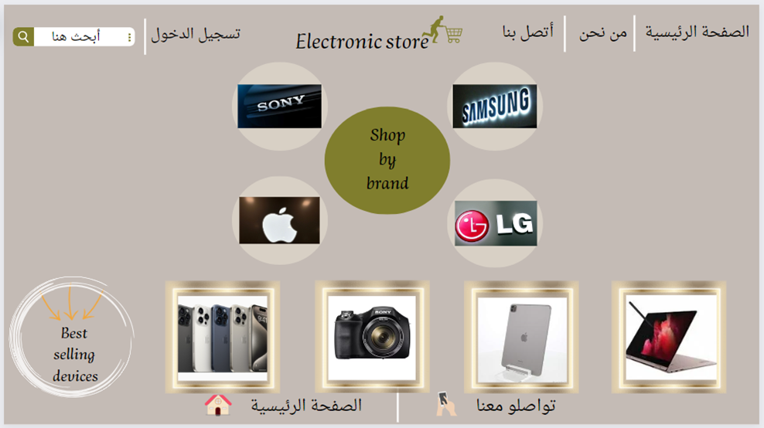
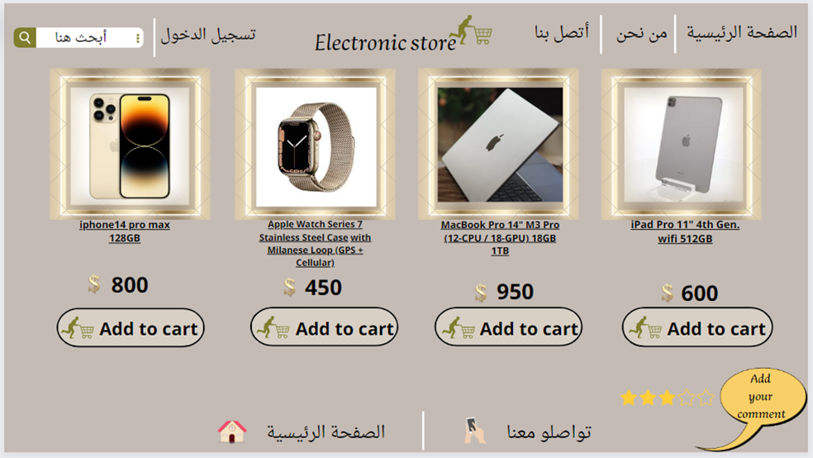
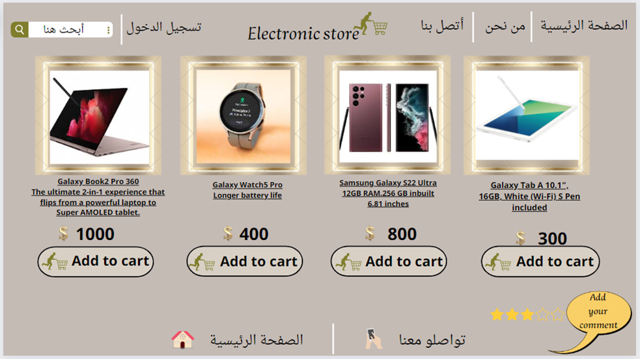
Shop by brand page design
Apple electronics page design
Samsung electronics page design

Slide 36
12
Future works

Slide 37
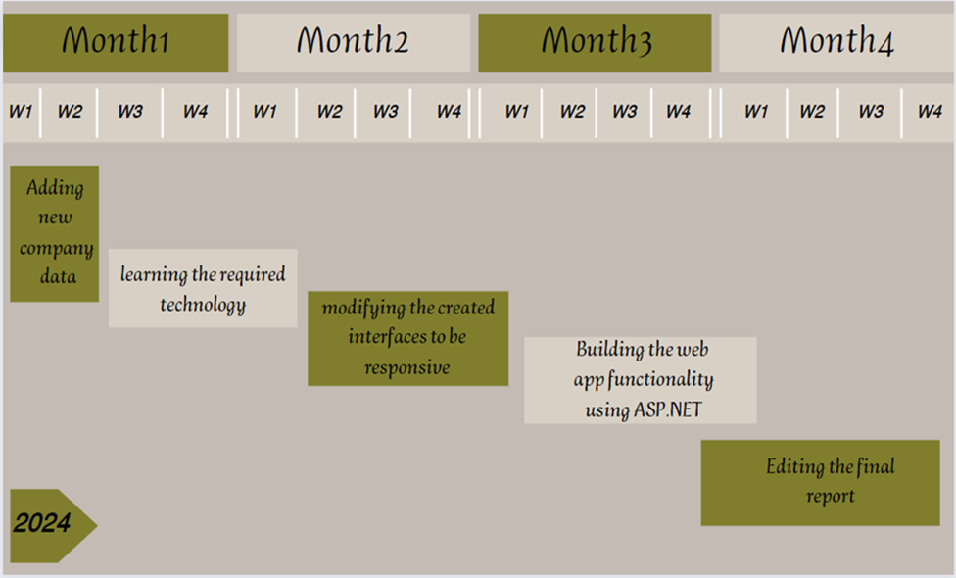

Slide 38
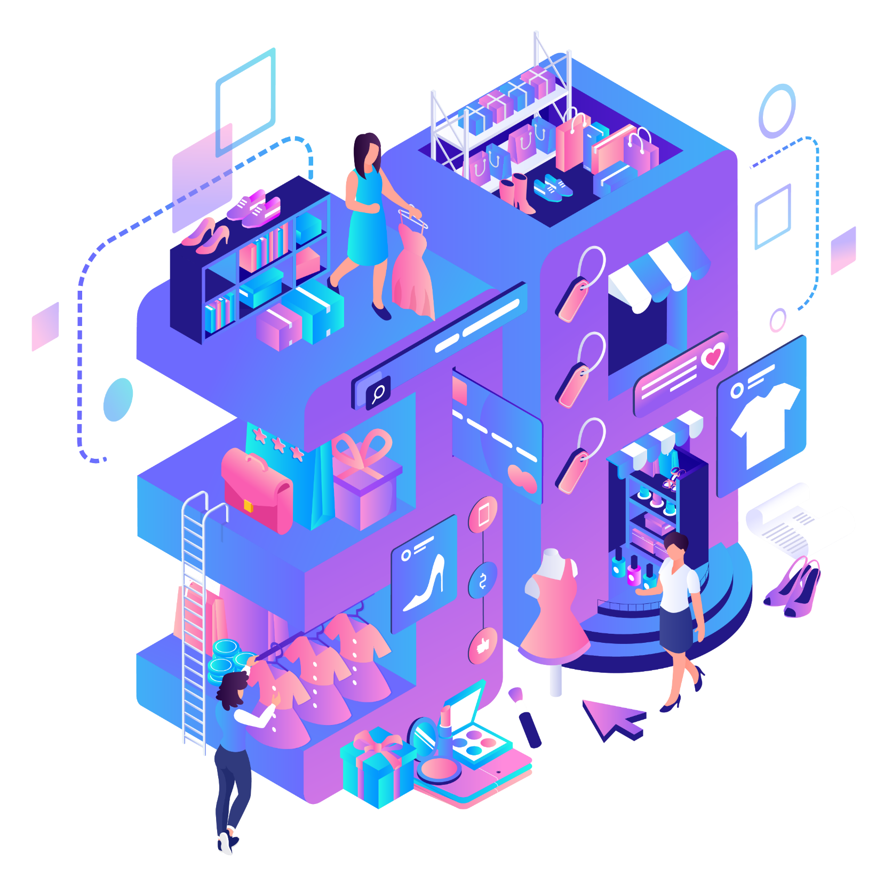
Electronic store
Thank you for watching
2024

